Slide 1

Classifying Medical Documents
General Assembly Data Science Part Time (Jan-Mar 2017) – Final Project
Sierra Costanza

Slide 2
Introduction
Project Objective: Medical practices handle a large amount of documents for each of their patients (many coming from different sources) that often require manual work of administrators to classify, compile and file. My friend Brian is developing a startup called WaitingRoomApp, an app that helps automate several aspects of the waiting room in medical practices. This project helps with the task of automating the process of classifying the documents that the practices receive (supervised multi-class classification), and could eventually serve as one of WaitingRoomApp's product offerings. If successful for several types of documents, this project would save WaitingRoomApp's customers a considerable amount of time, money and resources.
Data Source: 4 types of medical document pdfs queried using the Microsoft Bing Web Search API:
medical release forms
informed consent forms
patient intake forms
"catch all" bucket for other general medical forms that do not fit those 3 types
Built models using the data at both the document level and page level
Target variable = document type

Slide 3
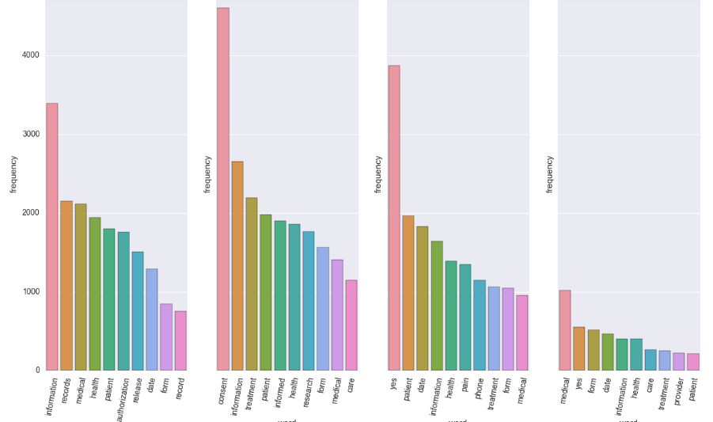
EDA and Feature Engineering
Class Distribution
Data | Release Forms | Consent Forms | Intake Forms | ‘Other’
Document Level | 306 (23%) | 467 (35%) | 488 (36%) | 87 (6%)
 | Total: 1,348
Page Level | 601 (12%) | 2,135 (41%) | 2,170 (42%) | 246 (5%)
 | Total: 5,152
Data | Release Forms | Consent Forms | Intake Forms | ‘Other’
Document Level | 296 (31%) | 278 (29%) | 295 (31%) | 82 (9%)
 | Total: 951 | # words in corpus: 38,511
Page Level | 578 (16%) | 1,510 (42%) | 1,305 (36%) | 237 (7%)
 | Total: 3,630 | # words in corpus: 37,712
Removed
Duplicates
Most Frequent Words per Class
Release Forms | Consent Forms | Intake Forms | ‘Other’

Slide 4
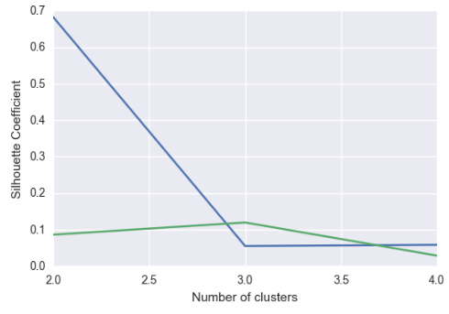
EDA and Feature Engineering
Clustering – is there inherent structure to the data without using the class labels?
Clustering performed on (scaled) Tf-Idf matrix for document level data (English stop words, 10K max features)
All documents
First 3 types
(‘Other’ removed)
Presence of ‘Other’ type makes 4 distinct document types hard to detect when all documents are included in clustering. This may (and did!) pose a problem when modeling
When ‘Other’ is removed, 3 clusters are optimal and detected (although fairly low Silhouette Coefficient)

Slide 5

Modeling
Split data into 75% train, 25% test
Used Tf-Idf matrix (Just Tf performed similarly)
Also tried using stems, but performed similarly/slightly worse in all cases
1. Multinomial Naive Bayes – Didn’t work well for 4th class
Parameters Tuned:
Stop words (None, English), Max features, N-grams, Min df
NB: Fit prior (True/False), class prior (None, all equal)
Used Grid Search with 4-fold cross validation on training data
Also tried modeling using just the first 3 classes, taking the best model and manually classifying the 4th class with probability thresholds, but didn’t perform as well as other algorithms below
2. RandomForest – Performed slightly better on Document Level data, worse on average
Parameters Tuned:
Max features, N-grams, Min df
RandomForest: Class weight, # estimators, max features, min samples split/leaf, criterion
Used Grid Search with 3-fold cross validation on training data
Final Models:
DOCUMENT LEVEL DATA - RandomForest Stop words = English, max features = 30,000 N-grams = (1,3), min df = 3 Class weight = Balanced # estimators = 10 (!), max features = 3,000, min samples leaf/split = 3, max depth=None, criterion = entropy PAGE LEVEL DATA – Linear SVM with SGD Stop words = English, max features = 32,000 N-grams = (1,3), min df = 1 Class weight = Balanced SGD: alpha = 0.0003, # iterations = 13
3. Linear SVM (‘hinge’ loss function) with SGD
Parameters Tuned:
Stop words (None, English), Max features, N-grams, Min df
SGD: Class weight, alpha, # iterations
Used Grid Search with 4-fold cross validation on training data

Slide 6
Results
Multinomial Naive Bayes – Didn’t work well for 4th class
Confusion Matrix (test data)
Accuracy
86.1%
Confusion Matrix (test data)
Accuracy
87.9%
 | 1 | 2 | 3 | 4
1 | 69 | 1 | 0 | 0
2 | 2 | 68 | 6 | 0
3 | 2 | 3 | 68 | 0
4 | 7 | 3 | 9 | 0
 | 1 | 2 | 3 | 4
1 | 145 | 6 | 3 | 0
2 | 11 | 347 | 13 | 0
3 | 19 | 26 | 295 | 0
4 | 8 | 6 | 18 | 11
Precision
79%
Precision
89%
DOCUMENT LEVEL DATA
PAGE LEVEL DATA
Recall
86%
Recall
88%
F1
83%
F1
87%
RandomForest
Linear SVM with SGD
Confusion Matrix (test data)
Accuracy
94.1%
Confusion Matrix (test data)
Accuracy
94.2%
 | 1 | 2 | 3 | 4
1 | 68 | 1 | 0 | 1
2 | 1 | 72 | 2 | 1
3 | 0 | 3 | 69 | 4
4 | 2 | 1 | 1 | 15
 | 1 | 2 | 3 | 4
1 | 144 | 3 | 1 | 6
2 | 1 | 357 | 12 | 1
3 | 5 | 15 | 320 | 0
4 | 0 | 4 | 5 | 34
Precision
94%
Precision
94%
DOCUMENT LEVEL DATA
Recall
94%
PAGE LEVEL DATA
Recall
94%
F1
94%
F1
94%

Slide 7
Extension: Tensorflow
Implemented a Convolutional Neural Network on Words (Tf matrix)
Shown to work for text classification
Adapted from tensorflow open source Github repo example; uses tf.contrib.learn API
LOTS of parameters to tune – still more research to do here
Examples: number of filters, filter shapes, pooling window and stride, number of layers, optimizer & learning rate (SGD, ‘Adam’ (used here)), number of steps…
Results So Far
Confusion Matrix (test data)
Accuracy
75.6%
Confusion Matrix (test data)
Accuracy
75.3%
 | 1 | 2 | 3 | 4
1 | 56 | 1 | 2 | 11
2 | 3 | 58 | 3 | 12
3 | 0 | 3 | 56 | 14
4 | 3 | 3 | 3 | 10
 | 1 | 2 | 3 | 4
1 | 113 | 30 | 10 | 1
2 | 53 | 311 | 4 | 3
3 | 73 | 10 | 257 | 0
4 | 22 | 9 | 9 | 3
Precision
84%
Precision
79%
DOCUMENT LEVEL DATA
PAGE LEVEL DATA
Recall
76%
Recall
75%
F1
79%
F1
76%

Slide 8
Next Steps
Model with more documents and for more medical document classes
Image Classification: Just a text classifier might not be sufficient for all potential use cases; for instance, medical practices could receive faxes or photocopies of documents that are rotated and the text might not be extractable. A next phase of the project would be to implement image classification using Convolutional Neural Networks with the document page inputs as images instead of text from pdfs.
Product Integration: Turning the model into a polished tool, plus future WaitingRoomApp customers (consumers of the model) would likely expect the input document or page files to be automatically moved into folders representing each predicted class by the model, for example – both will require more work with help from engineers.

Slide 9
References
http://scikit-learn.org/stable/tutorial/text_analytics/working_with_text_data.html
https://www.cs.cornell.edu/people/tj/publications/joachims_98a.pdf
http://www.iajet.org/iajet_files/vol.2/no.4/Medical%20Documents%20Classification%20Based%20on%20the%20Domain%20Ontology%20MeSH.pdf
https://github.com/tensorflow/tensorflow/tree/master/tensorflow/examples/learn#text-classification
https://github.com/tensorflow/tensorflow/blob/master/tensorflow/examples/learn/text_classification_cnn.py

